Slide 1
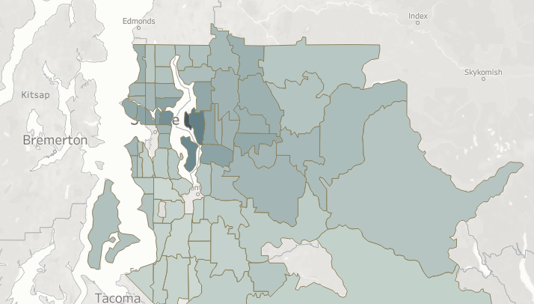
Mid_Bootcamp Project Case Study: Regression MODEL (Property PRICE prediction)
Group Room#6 (Chuk Leng Lim, Alen Pavlić Ravšer, Sebastian Günther, Dennis Nkansah-Tieku)
Notes:
Alen – introduction to our team

Slide 2

Background
We want to examine the real estate market and build a tool for the property price prediction Our company wants to explore which factors affecting property value the most – for prices above $650K
Tasks and organisation
To examine the data and to address all attributes that have the biggest impact on the price
To predict the dynamics of market prices – build an accurate model in Python
Visualise different variables from the dataset - evaluate factors that influence the price for sells over $650k
What were we working with?
A dataset with over 20,000 entries of sold properties
21 variables including time, space, property attributes and price
Notes:
Alen --- LAST SENTENCE:
Despite the limitation in the time frame of those sold properties, we had a quite interesting dataset that we needed to explore and use for our predictions and Sebastian will tell you more about the way we approached it.
Alen TRANSITION Sebastian
Sebastian --- LAST SENTENCE:
…
Sebastian TRANSITION Chuck

Slide 3
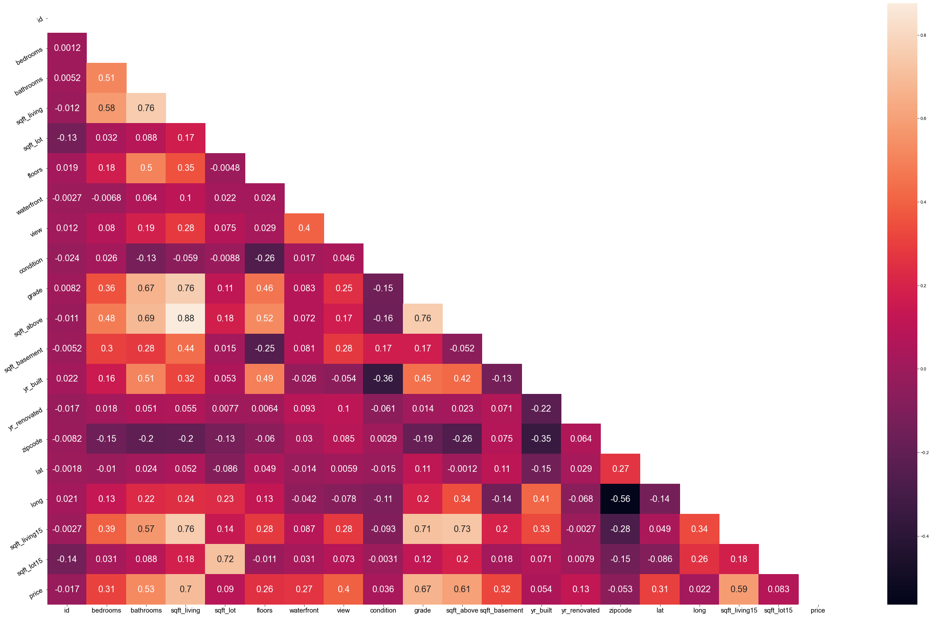
Data exploration
Understanding the Context
cleaning the data
defining different models
engineering new features
transforming the data
Notes:
Sebastian:
1) Understanding context, what make sense to build the model
2) cleaning or checking the data (but it is clean)
3) we find different model and compare see which one suit to build the model
4) we also made use of data to engineer new features to improve our model
5) some of the data are not normal and skew to right and left, so Transforming data to normal to improve the model
Sebastian LAST SENTENCE:
Now we have a deeper look on the models
Sebastian --- LAST SENTENCE:
…
Sebastian TRANSITION Chuck

Slide 4
Methodology & Model Improvement
First model: Linear regression
14 features + 1 target
R2 = 65.66%
KNN
R2 = 51.1%
Decision Tree
R2 = 54.8%
Linear regression
8 numericals
7 categoricals
R2 = 65.36%
Standard Scaler 14 numericals
R2 = 65.66%
Adding 2 features: Date & year renovated
R2 = 65.76%
Adding 3 feature: Lat, lang, zipcode 1 engineered features
R2 = 75.05%
Dropping two columns
R2=80.29%
Transform 4 variables to satisfy model
R2=88.43%
Notes:
Chuck -
Effect on R2 –

Slide 5
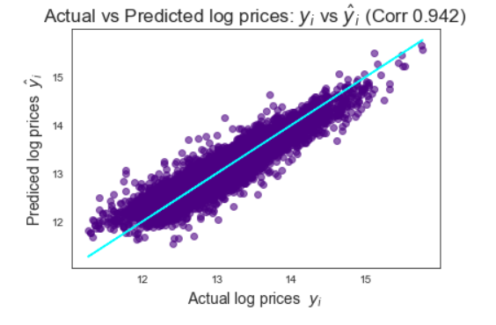
Model Outcomes
Notes:
Chuck
Accuracy
Chuck --- LAST SENTENCE:
….
Chuck TRANSITION Dennis

Slide 6
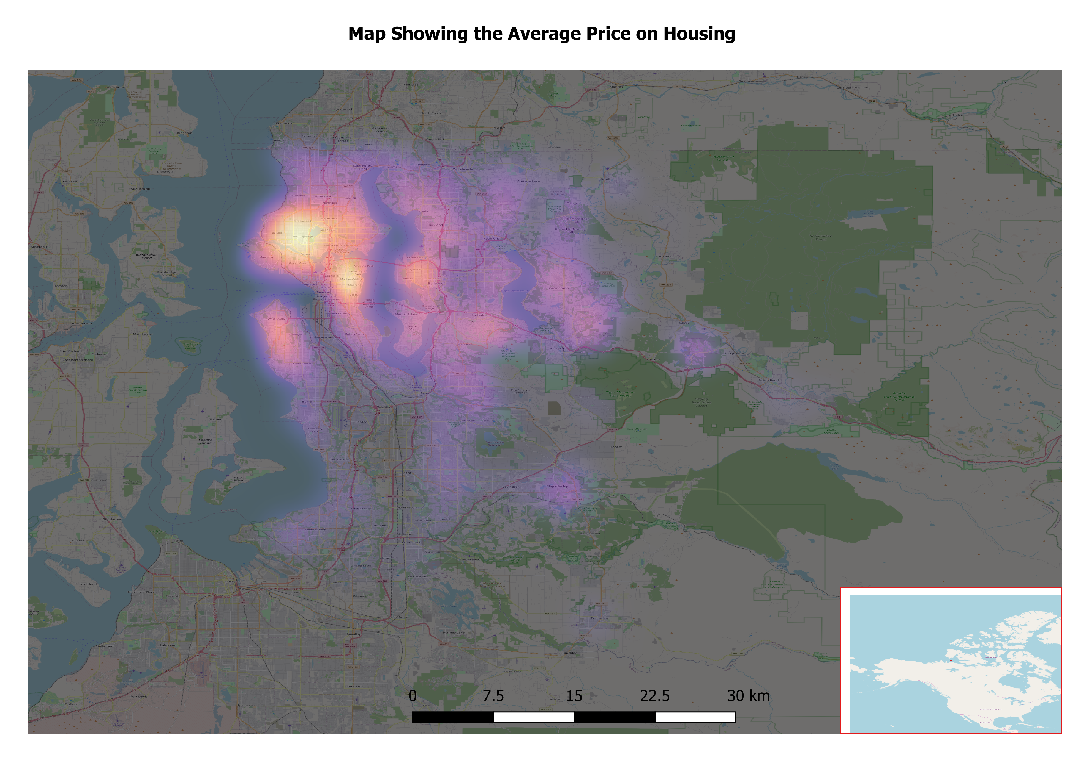
Conclusion
BIGGEST EFFECTS ON THE PRICE
Highlight of average price
Zipcodes
Distances from the central business district
Notes:
Dennis
Free conclusion overall
CONCLUSION:

Slide 7
Thank You!
If you HAVE DAtA to analyse, contact us:
trust.dataguys@propertyberlin.de
Group Room#6 (Chuk Leng Lim, Alen Pavlić Ravšer, Sebastian Günther, Dennis Nkansah-Tieku)

